Slide 1
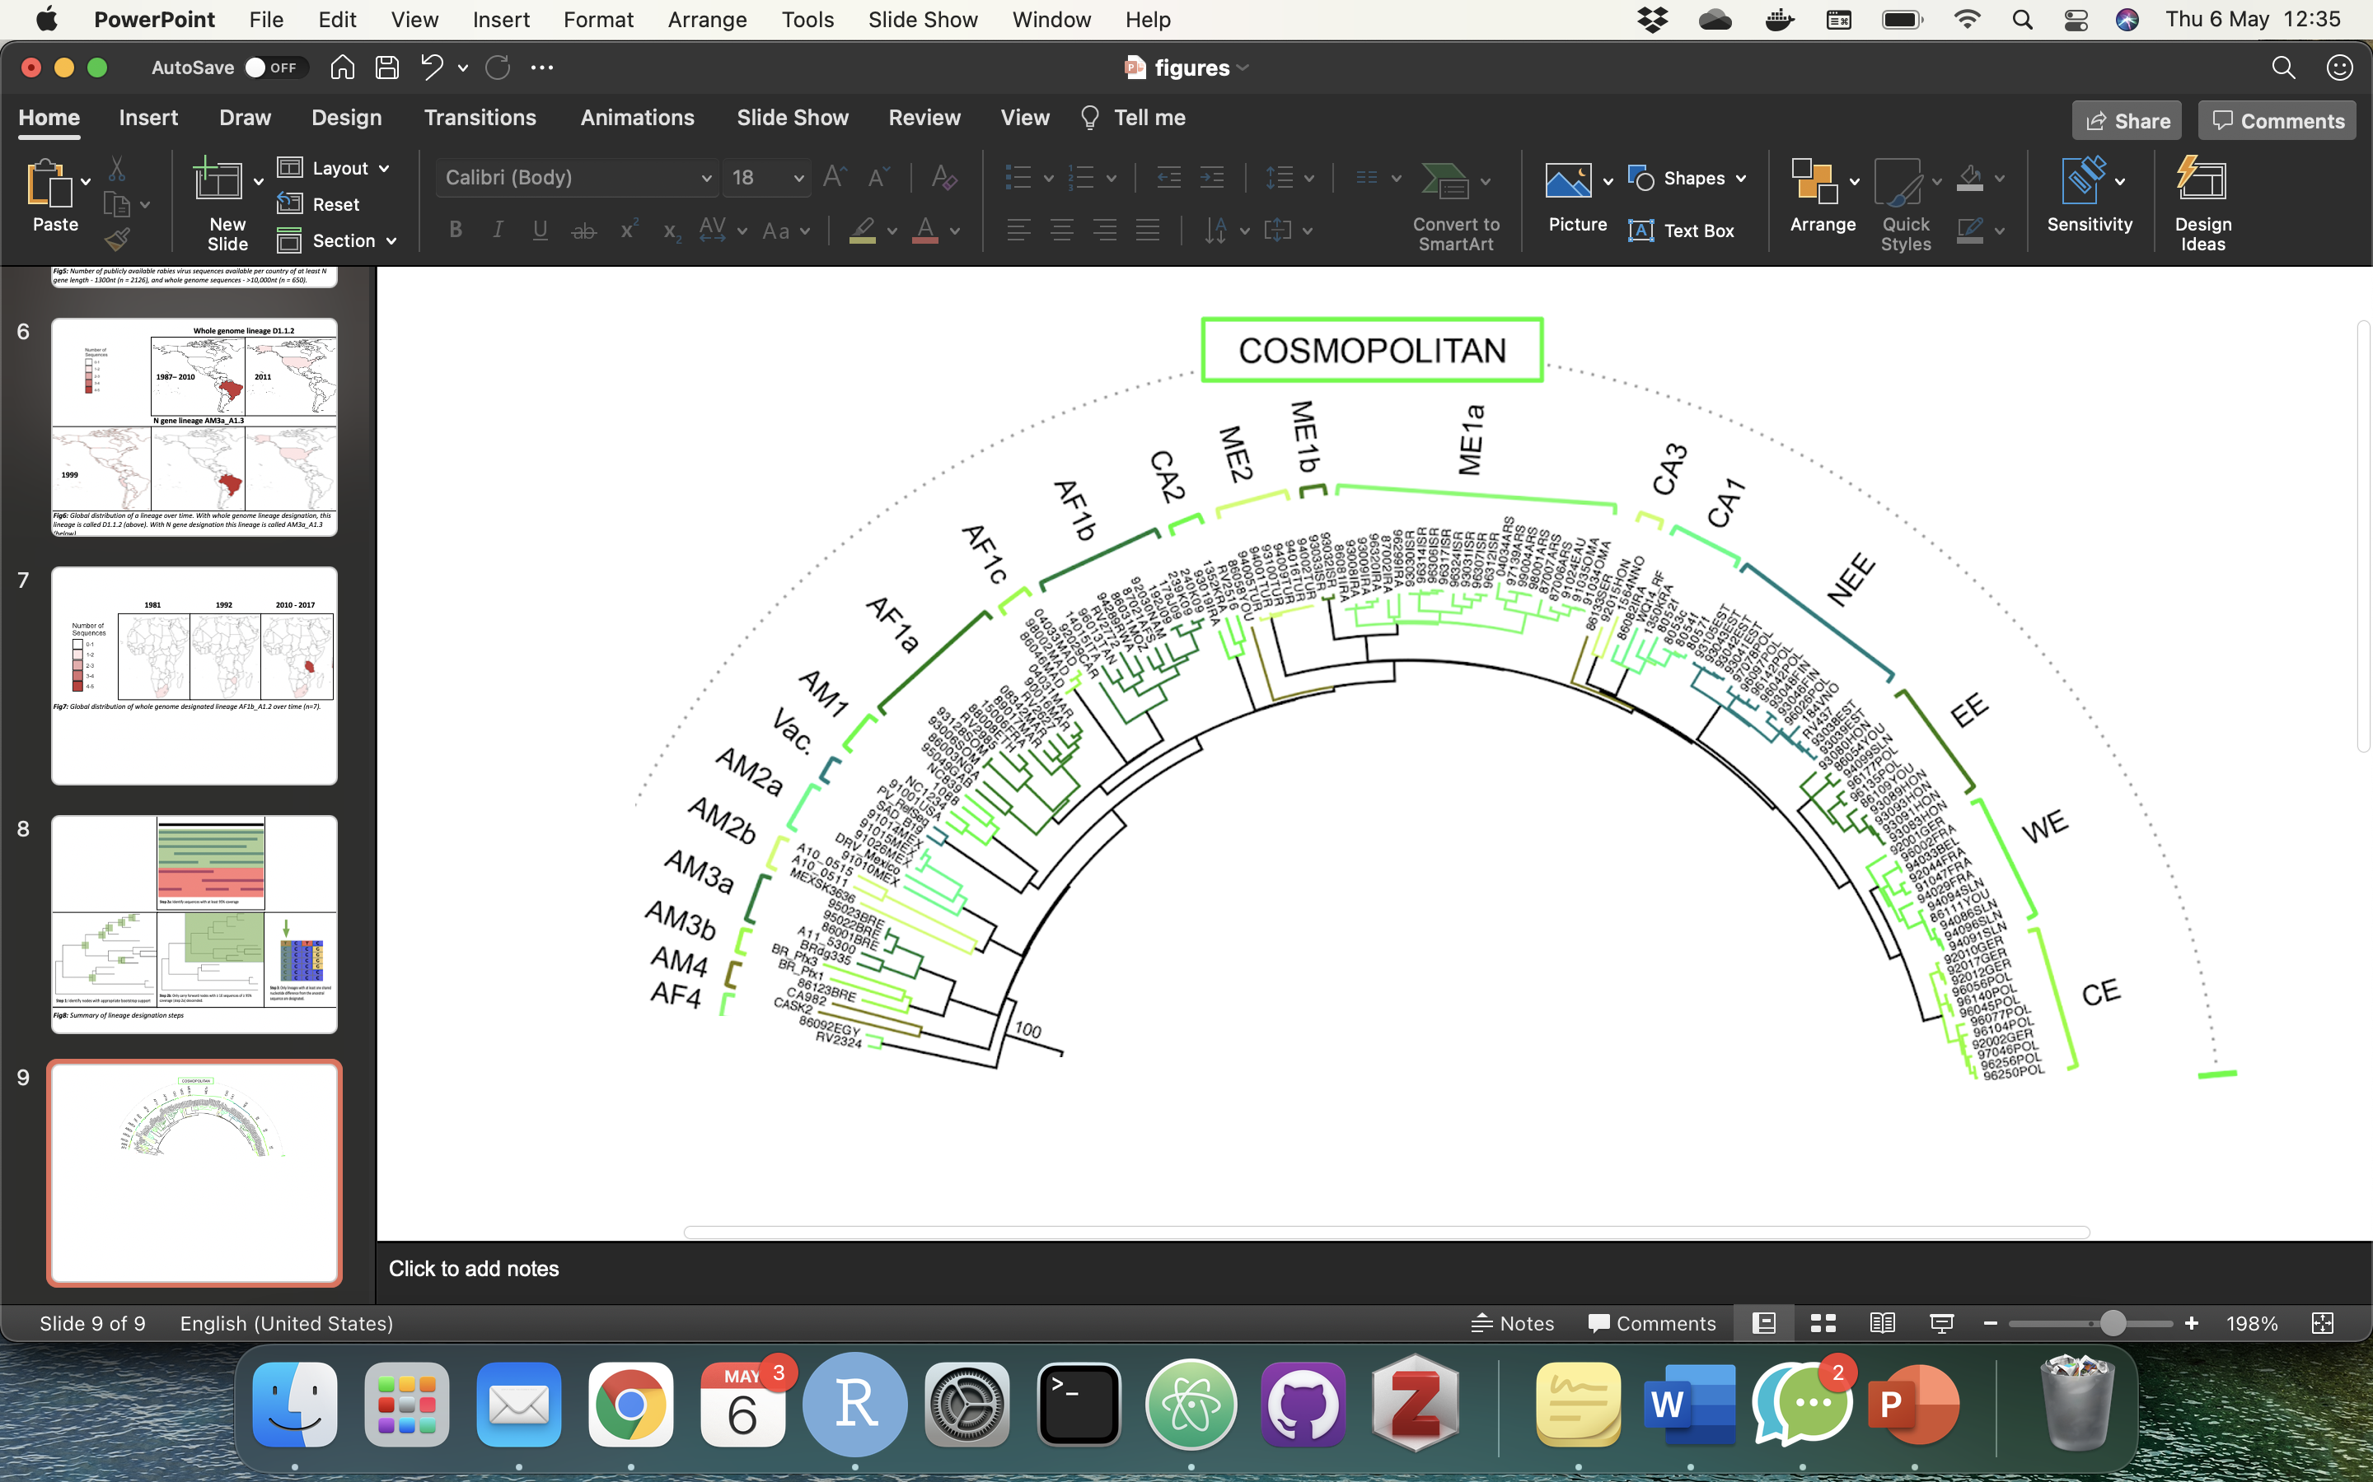
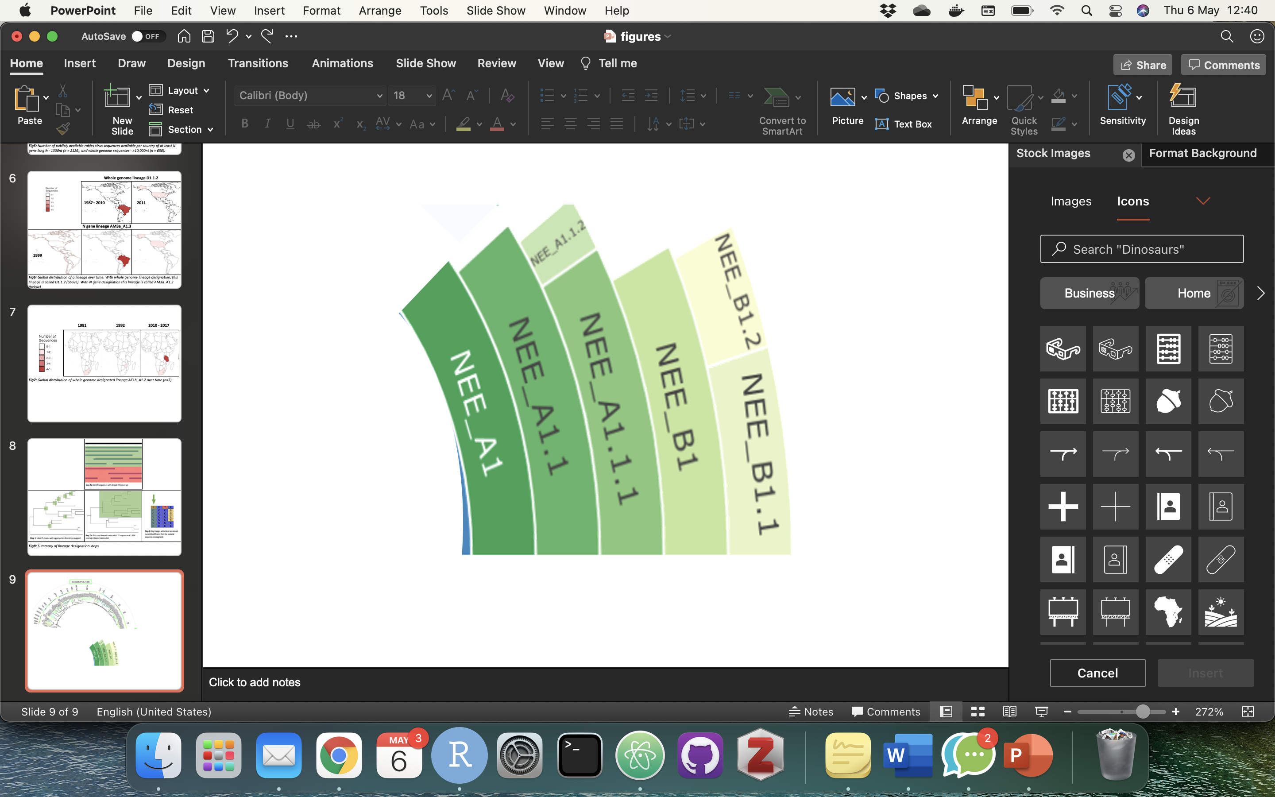
Clade
Subclade
Minor lineage
Major lineage
Notes:
Figure 1 - Definitions of clade and subclade from previous classification system, with subclade expanded to show definitions of major and minor lineages from updated classification system. Above part of figure adapted from Troupin et al. (2016)

Slide 2
Sequences from GenBank
User input sequences
INPUT
Curation
Web interface to database
Reference alignments, trees and sequences
Input sequences compared to references
PROCESSING
Options to filter
Downloadable sequences, metadata and alignments
Genome visualization and comparison to reference
Clade assignment
Placement in phylogenetic tree
OUTPUT
Notes:
Figure 2 - Schematic of the online capabilities of RABV-GLUE including obtaining sequences from GenBank, options to filter and download sequences of interest, and phylogenetic interpretation of user input sequences.

Slide 3
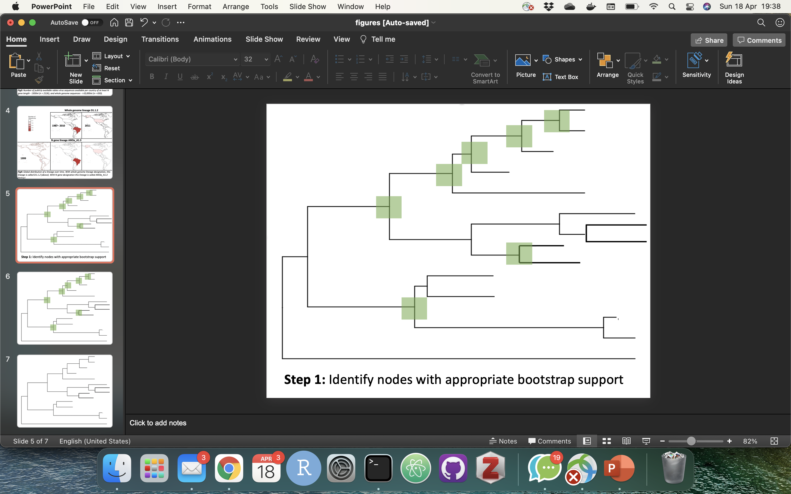
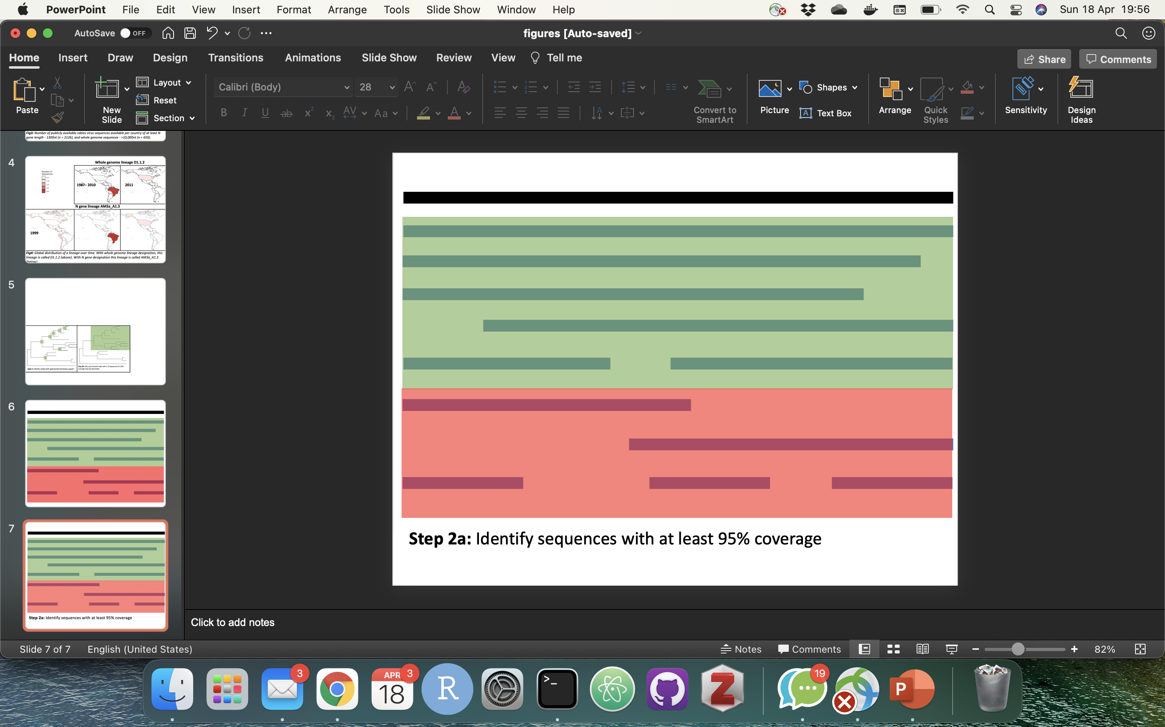
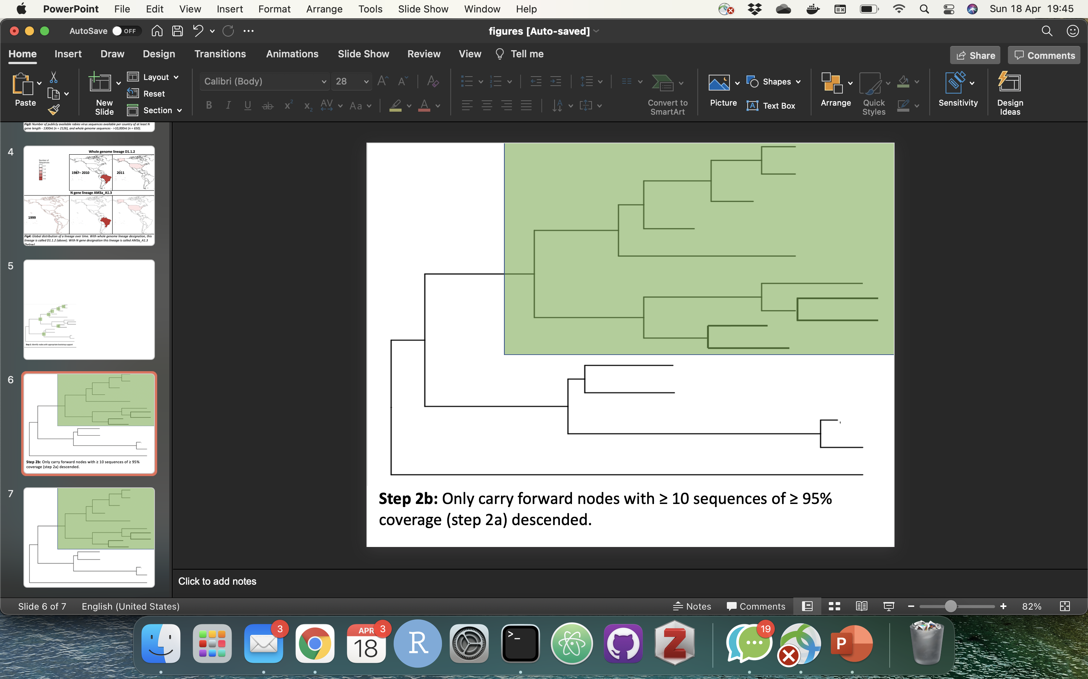
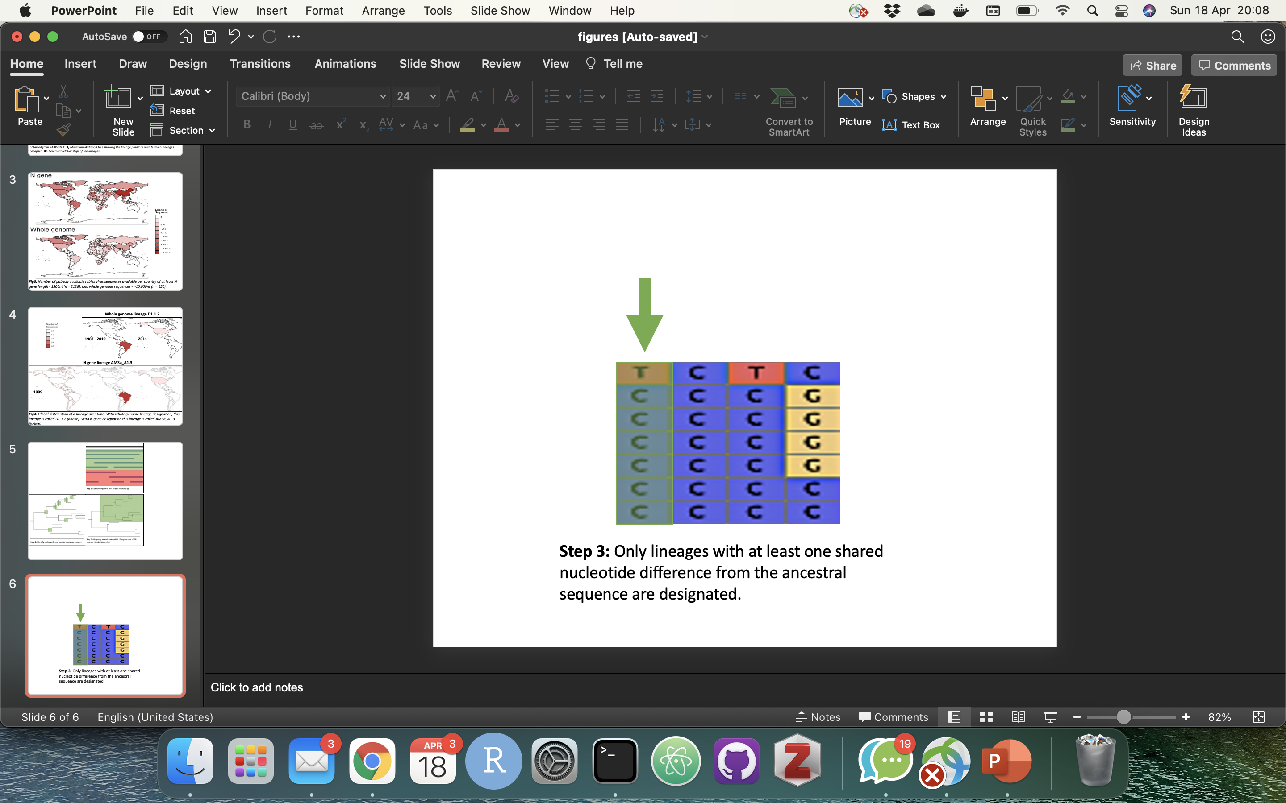
Step 4: Only lineages with at least one shared nucleotide difference from the ancestral sequence are designated
Step 1: Identify nodes with appropriate bootstrap support
Step 2: Identify sequences with at least 95% coverage
Step 3: Only carry forward nodes with ≥ 10 sequences of ≥ 95% coverage descended
Notes:
Figure 3 - Summary of lineage designation steps. Step 1 - Identify nodes with appropriate bootstrap support, Step 2 - Identify sequences with at least 95% coverage, Step 3 - Only carry forward nodes with at least 10 sequences of at least 95% coverage descended, Step 4 - Only lineages with at least one shared nucleotide difference from the ancestral sequence are designated.

Slide 4
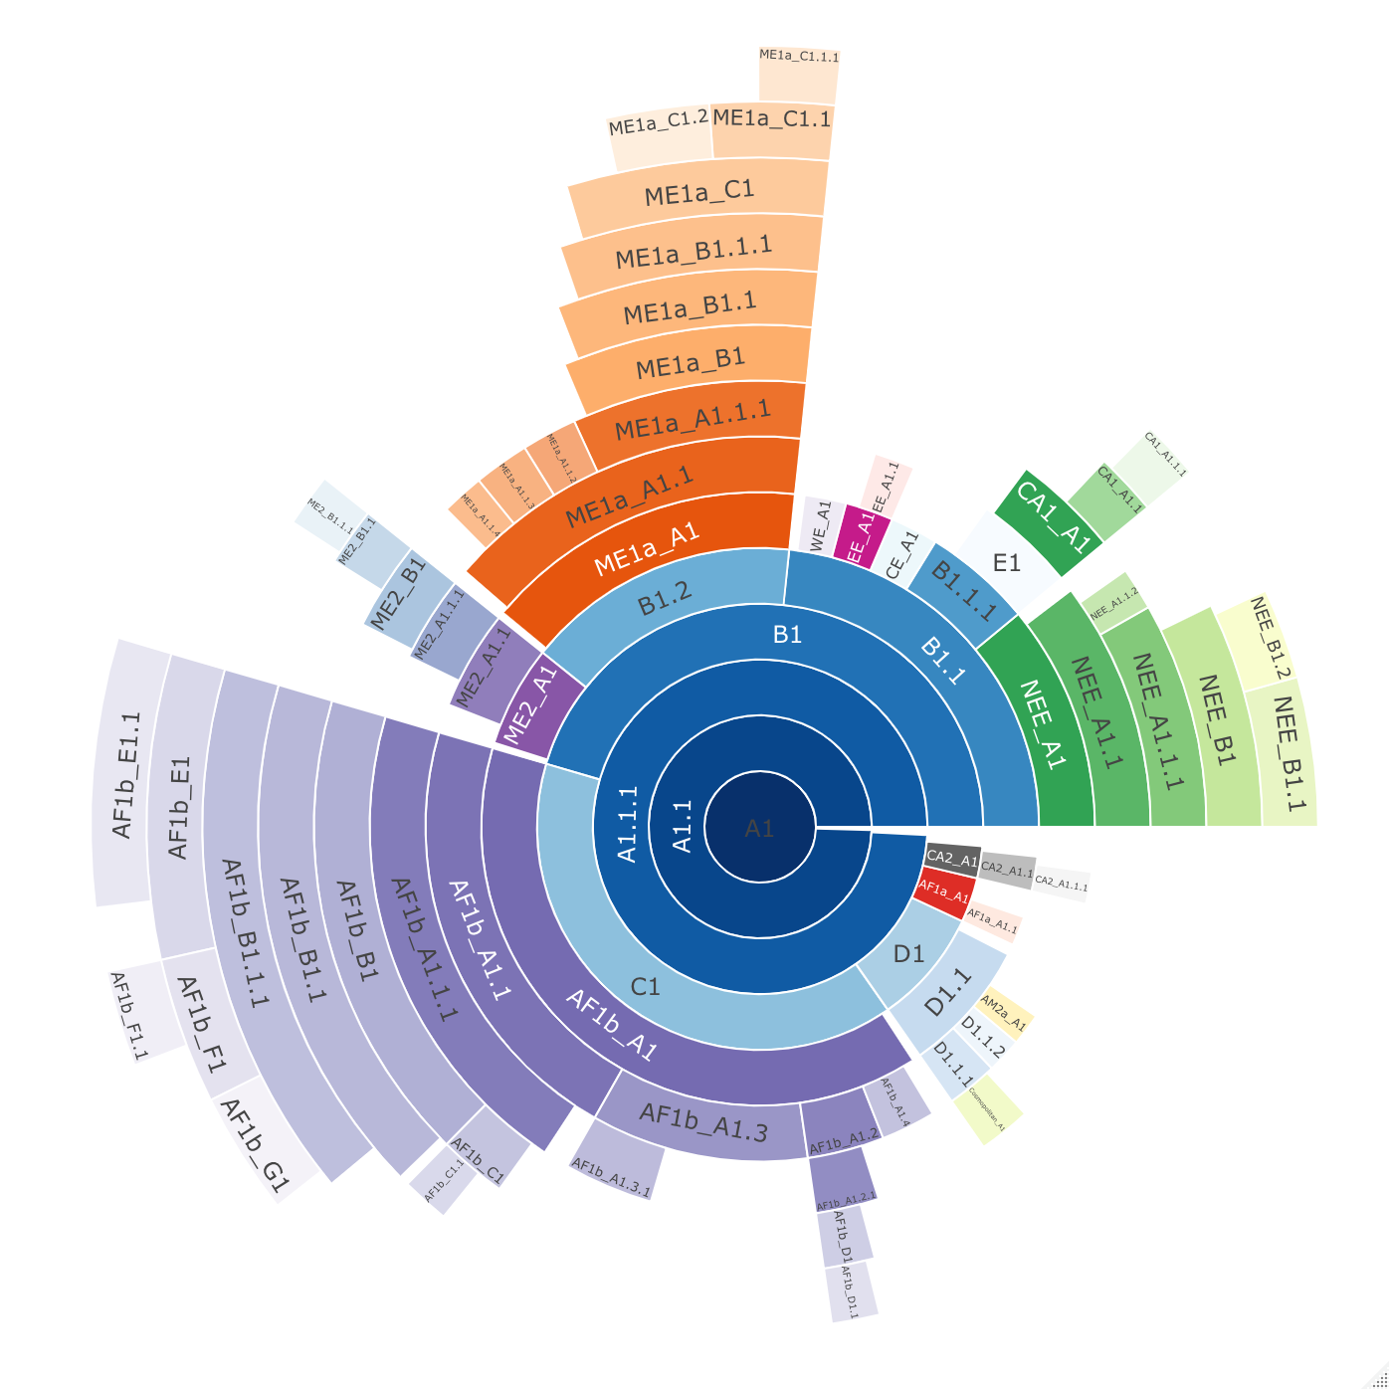
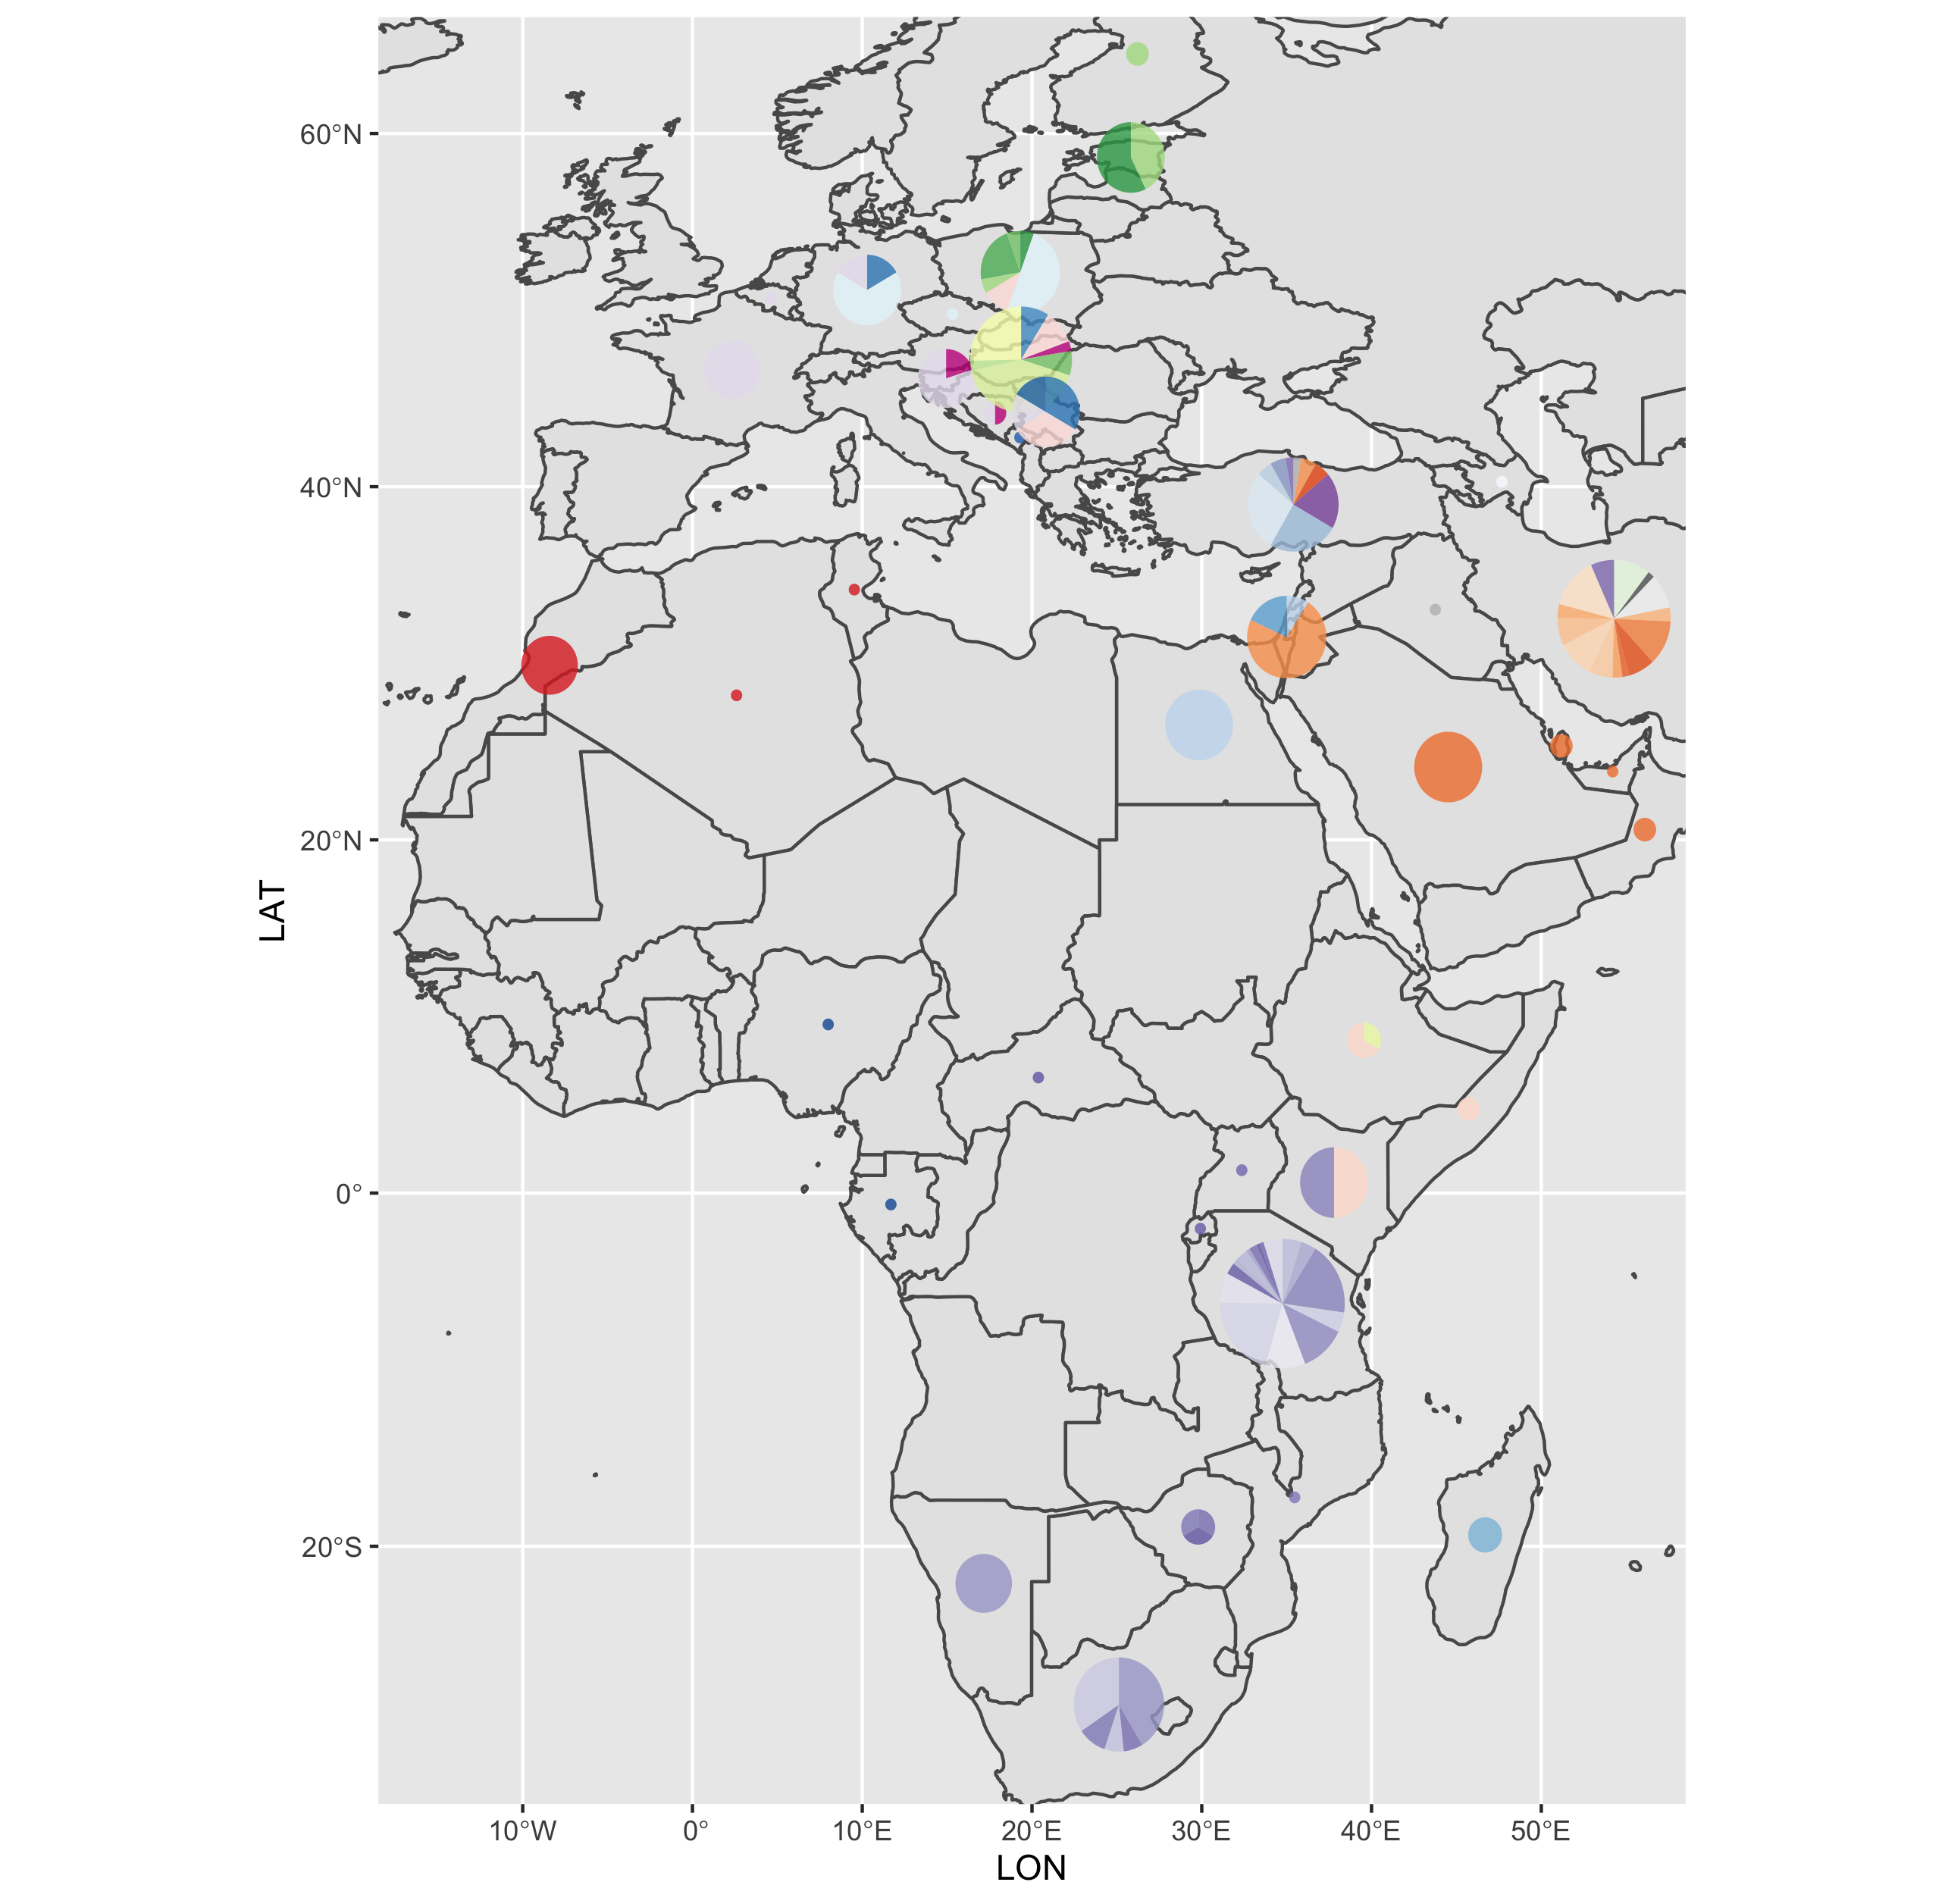
a)
b)
c)
d)
Notes:
Figure 4 - Lineage designation of 650 whole genome (10,000nt) rabies virus sequences from the Cosmopolitan clade, obtained from RABV-GLUE. A) Maximum likelihood tree showing the lineage positions with terminal lineages collapsed. B) Hierarchical relationships of the lineages. C) Proportions of lineages sequenced from each country. D) Lineage proportions zoomed in. Colours are comparable across all.

Slide 5
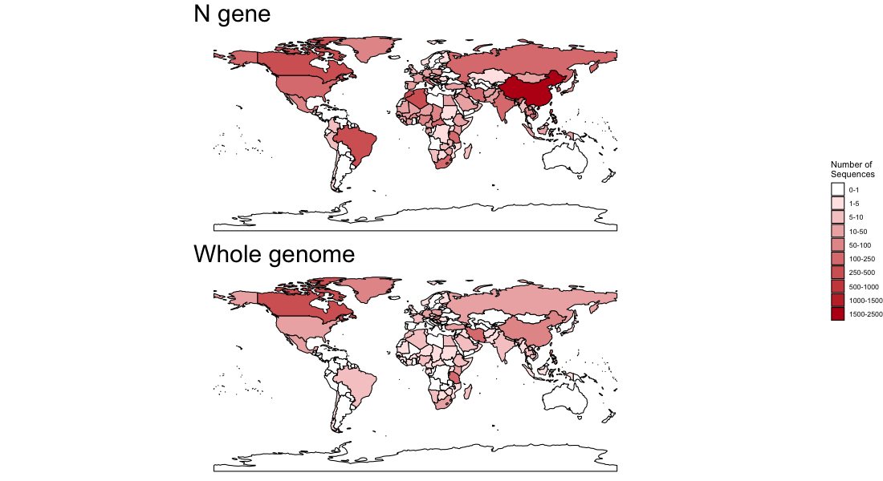
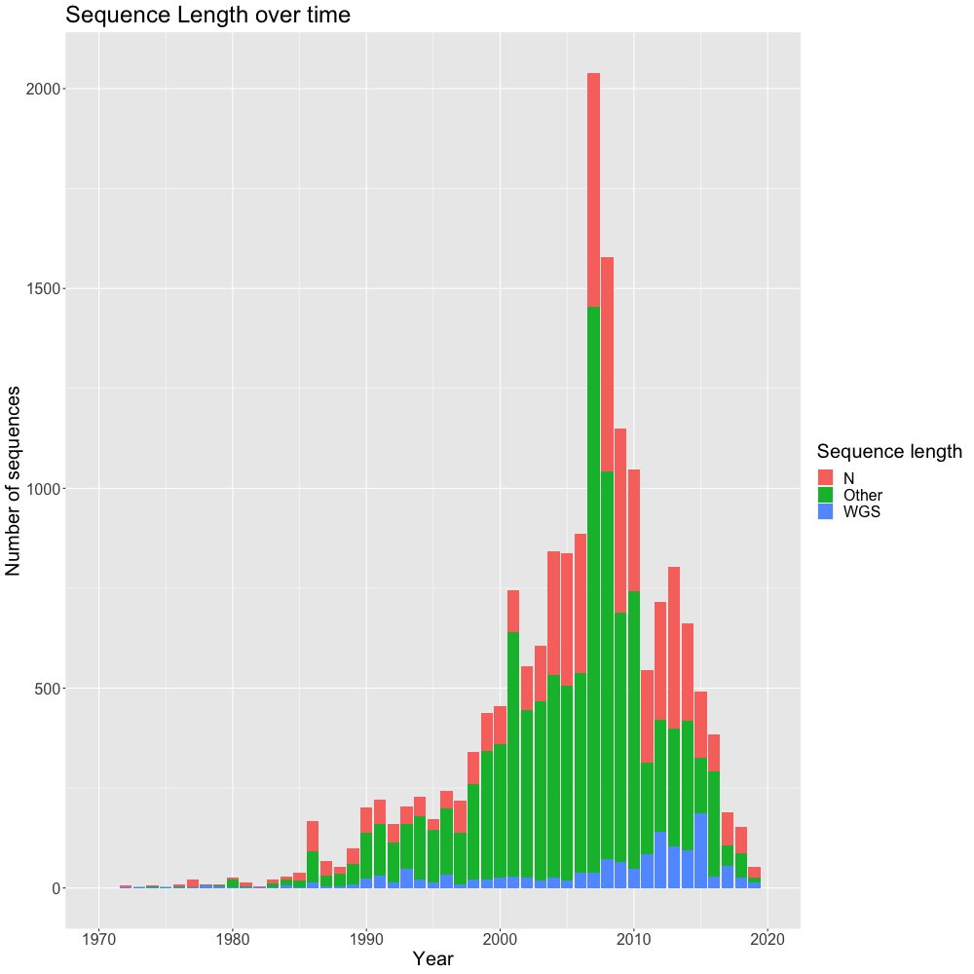
Notes:
Figure 5 – Left: Map of collection locations of all available whole genome and N gene sequences. Right: Time series of number of whole genome, N gene, and shorter sequences collected.

Slide 6
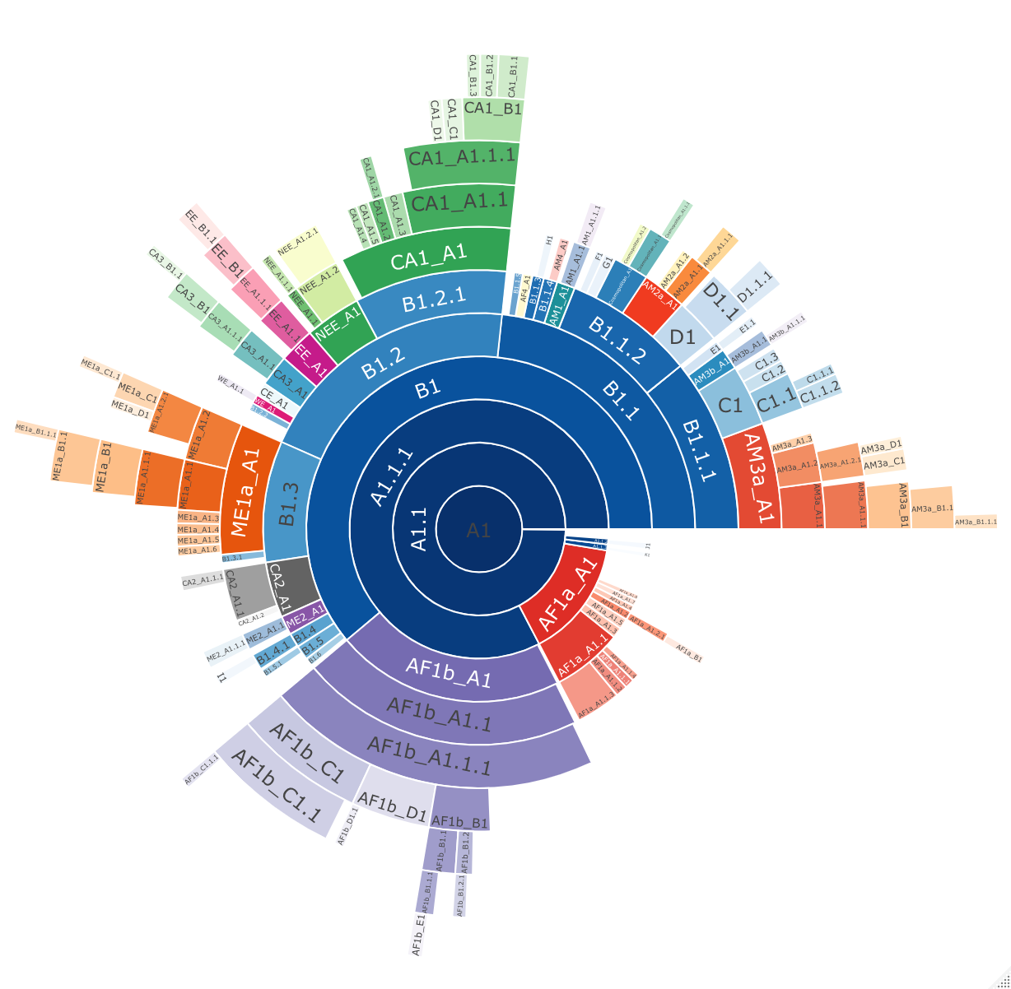
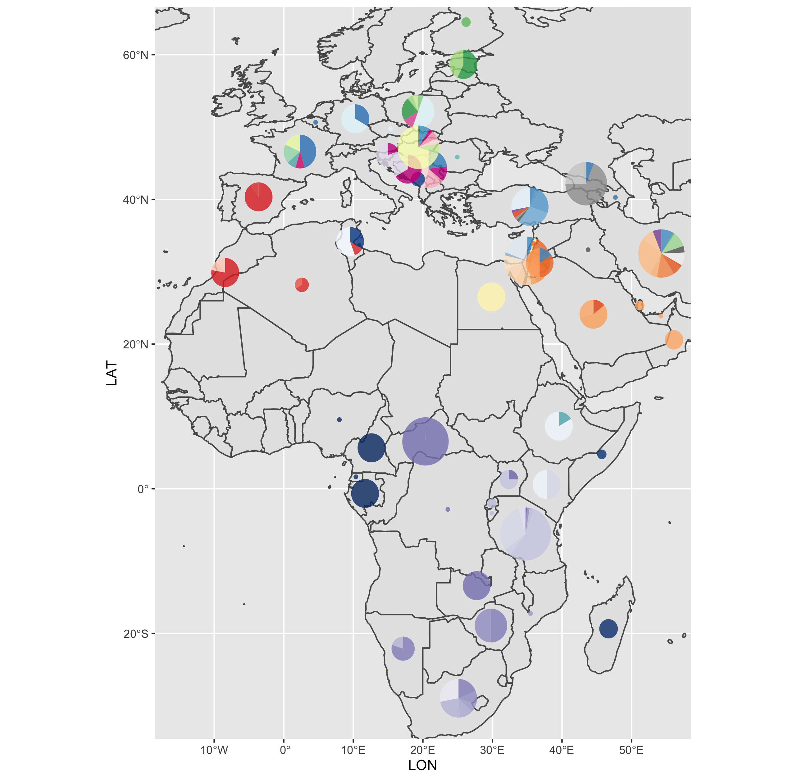
a)
b)
c)
d)
Notes:
Figure 6 - Lineage designation of the 2126 N gene length (1300nt) of rabies virus sequences from the Cosmopolitan clade, obtained from RABV-GLUE. A) Maximum likelihood tree showing the lineage positions with terminal lineages collapsed. B) Hierarchical relationships of the lineages. C) Proportions of lineages sequenced from each country. D) Lineage proportions zoomed in. Colours are comparable across all.

Slide 7
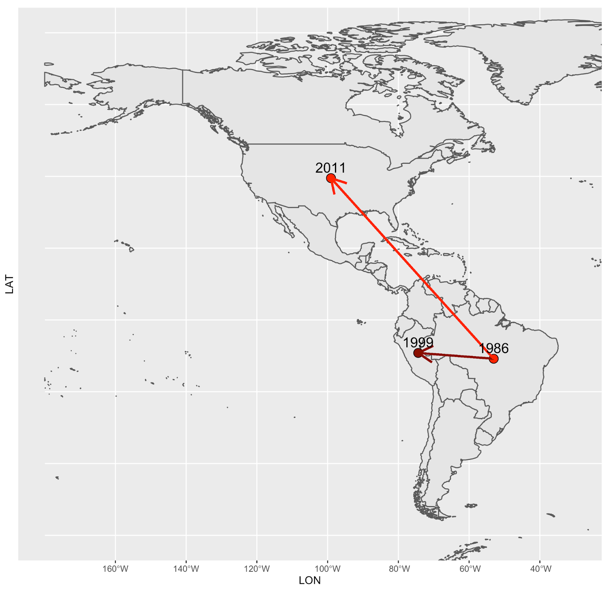
Notes:
Figure 7 - Global distribution of a lineage over time. Bright red indicates information from WGS lineage designation, whereas the darker red indicated the additional information from N gene lineage designation. Dated points represent introductions into countries, with arrows suggesting the likely route of introduction.

Slide 8
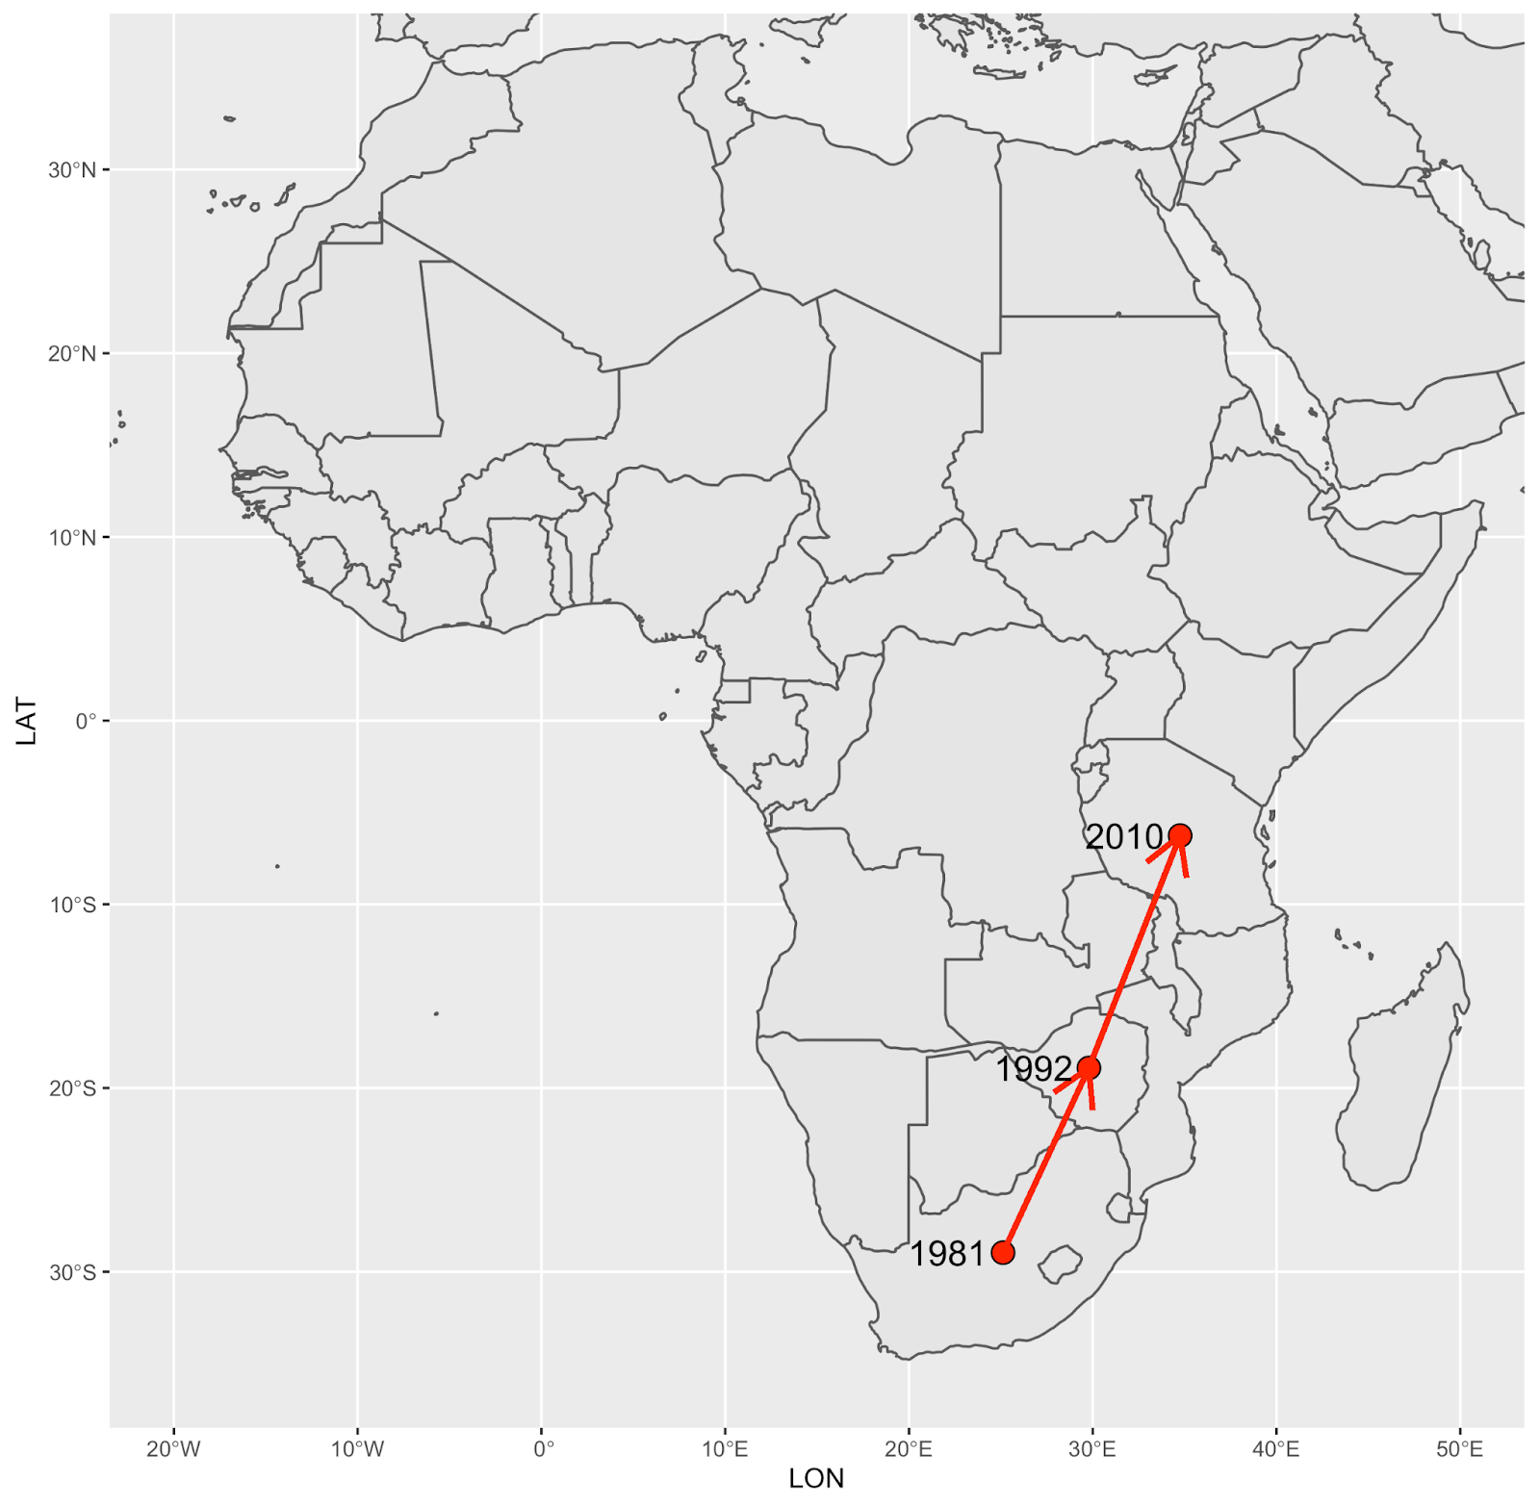
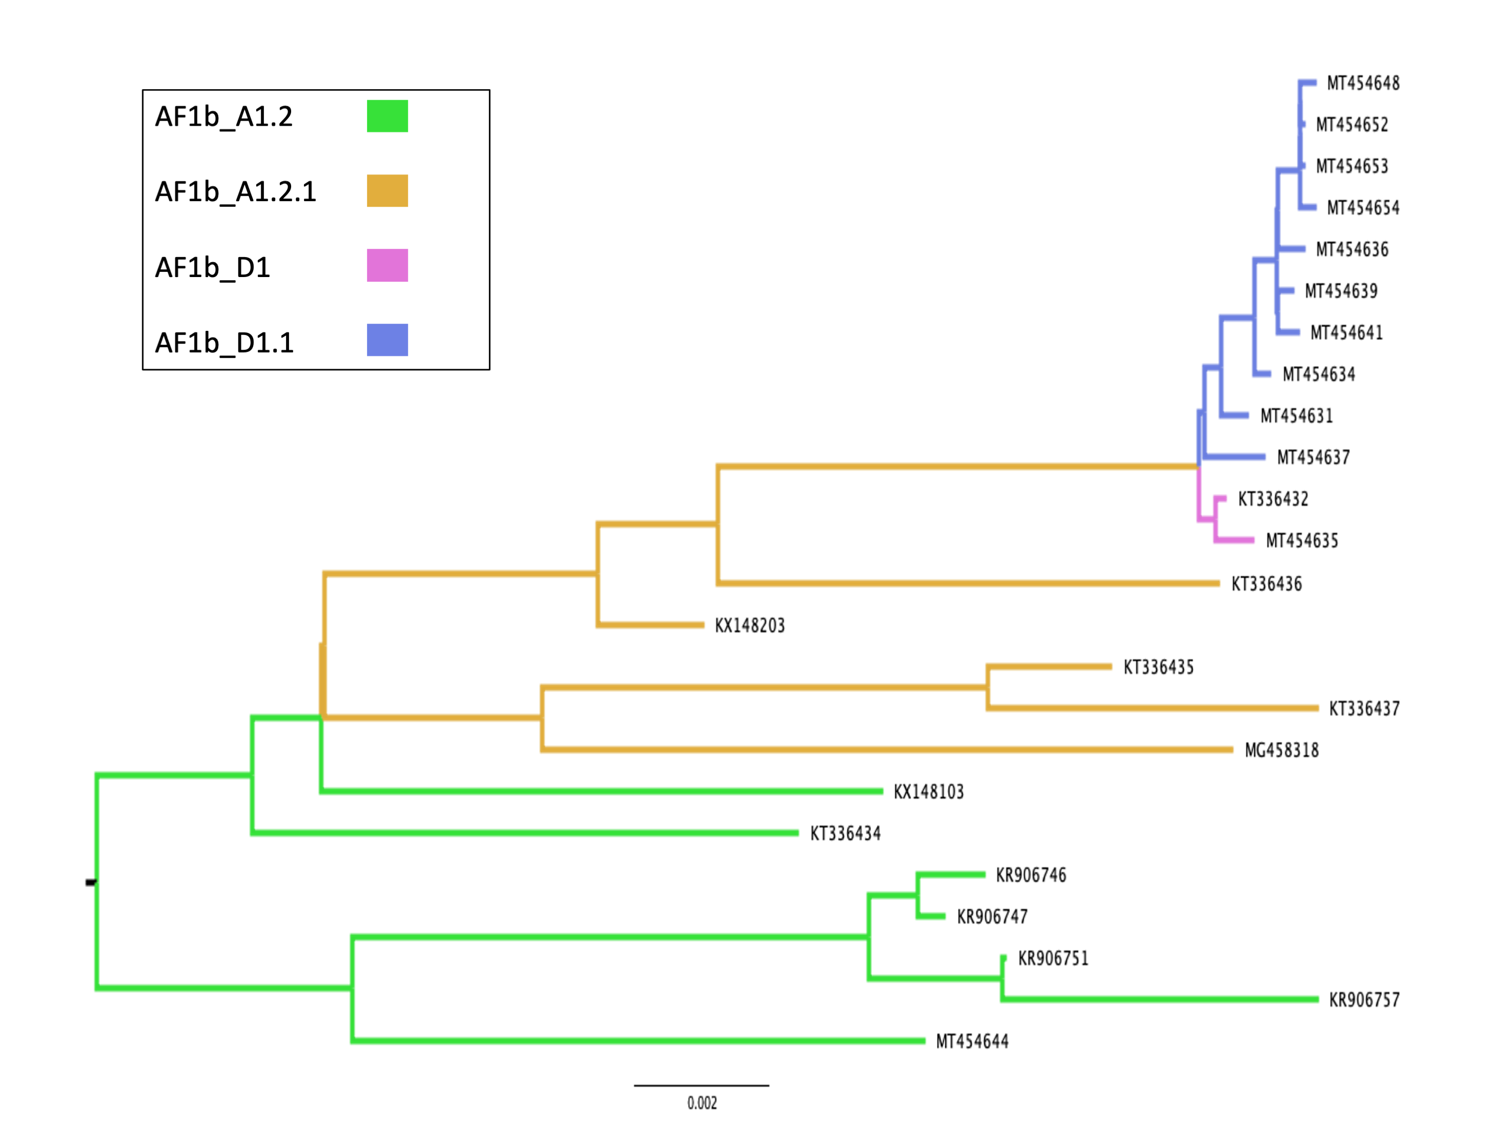
a)
b)
Notes:
Figure 8 - Global distribution of whole genome designated lineage AF1b_A1.2 over time (n=7) Dated points represent introductions into countries, with arrows suggesting the likely route of introduction.

Slide 9
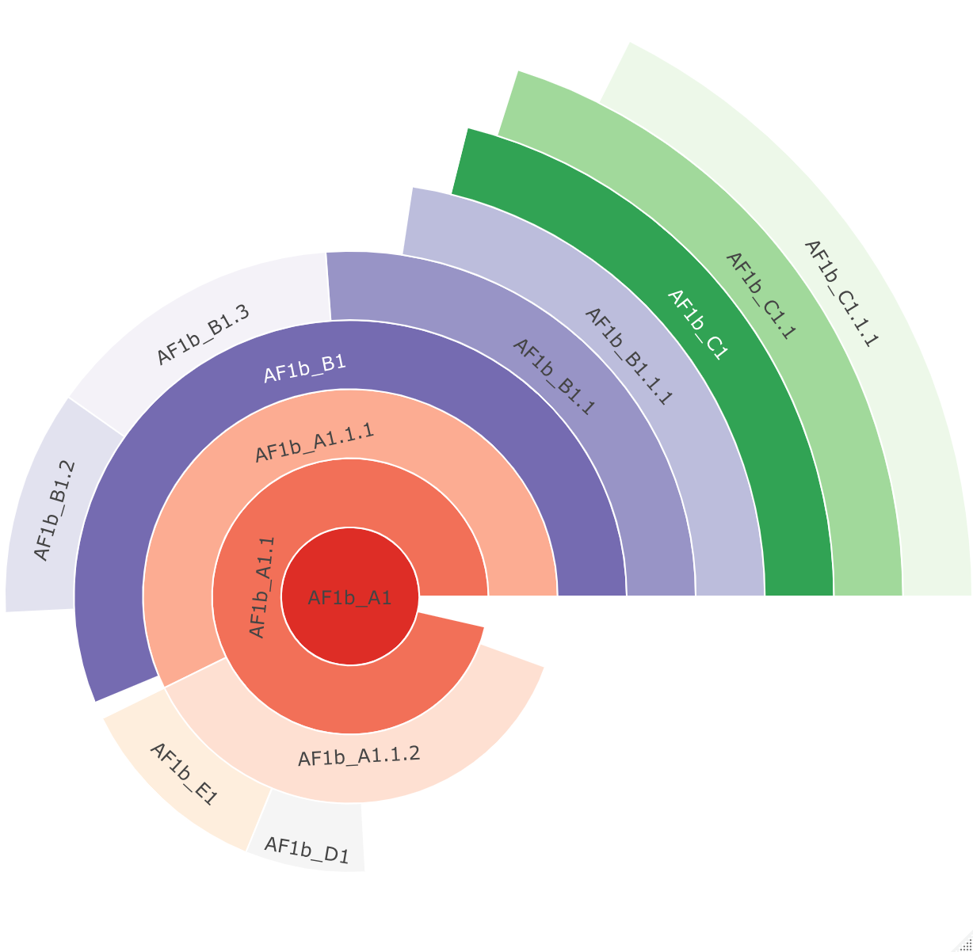
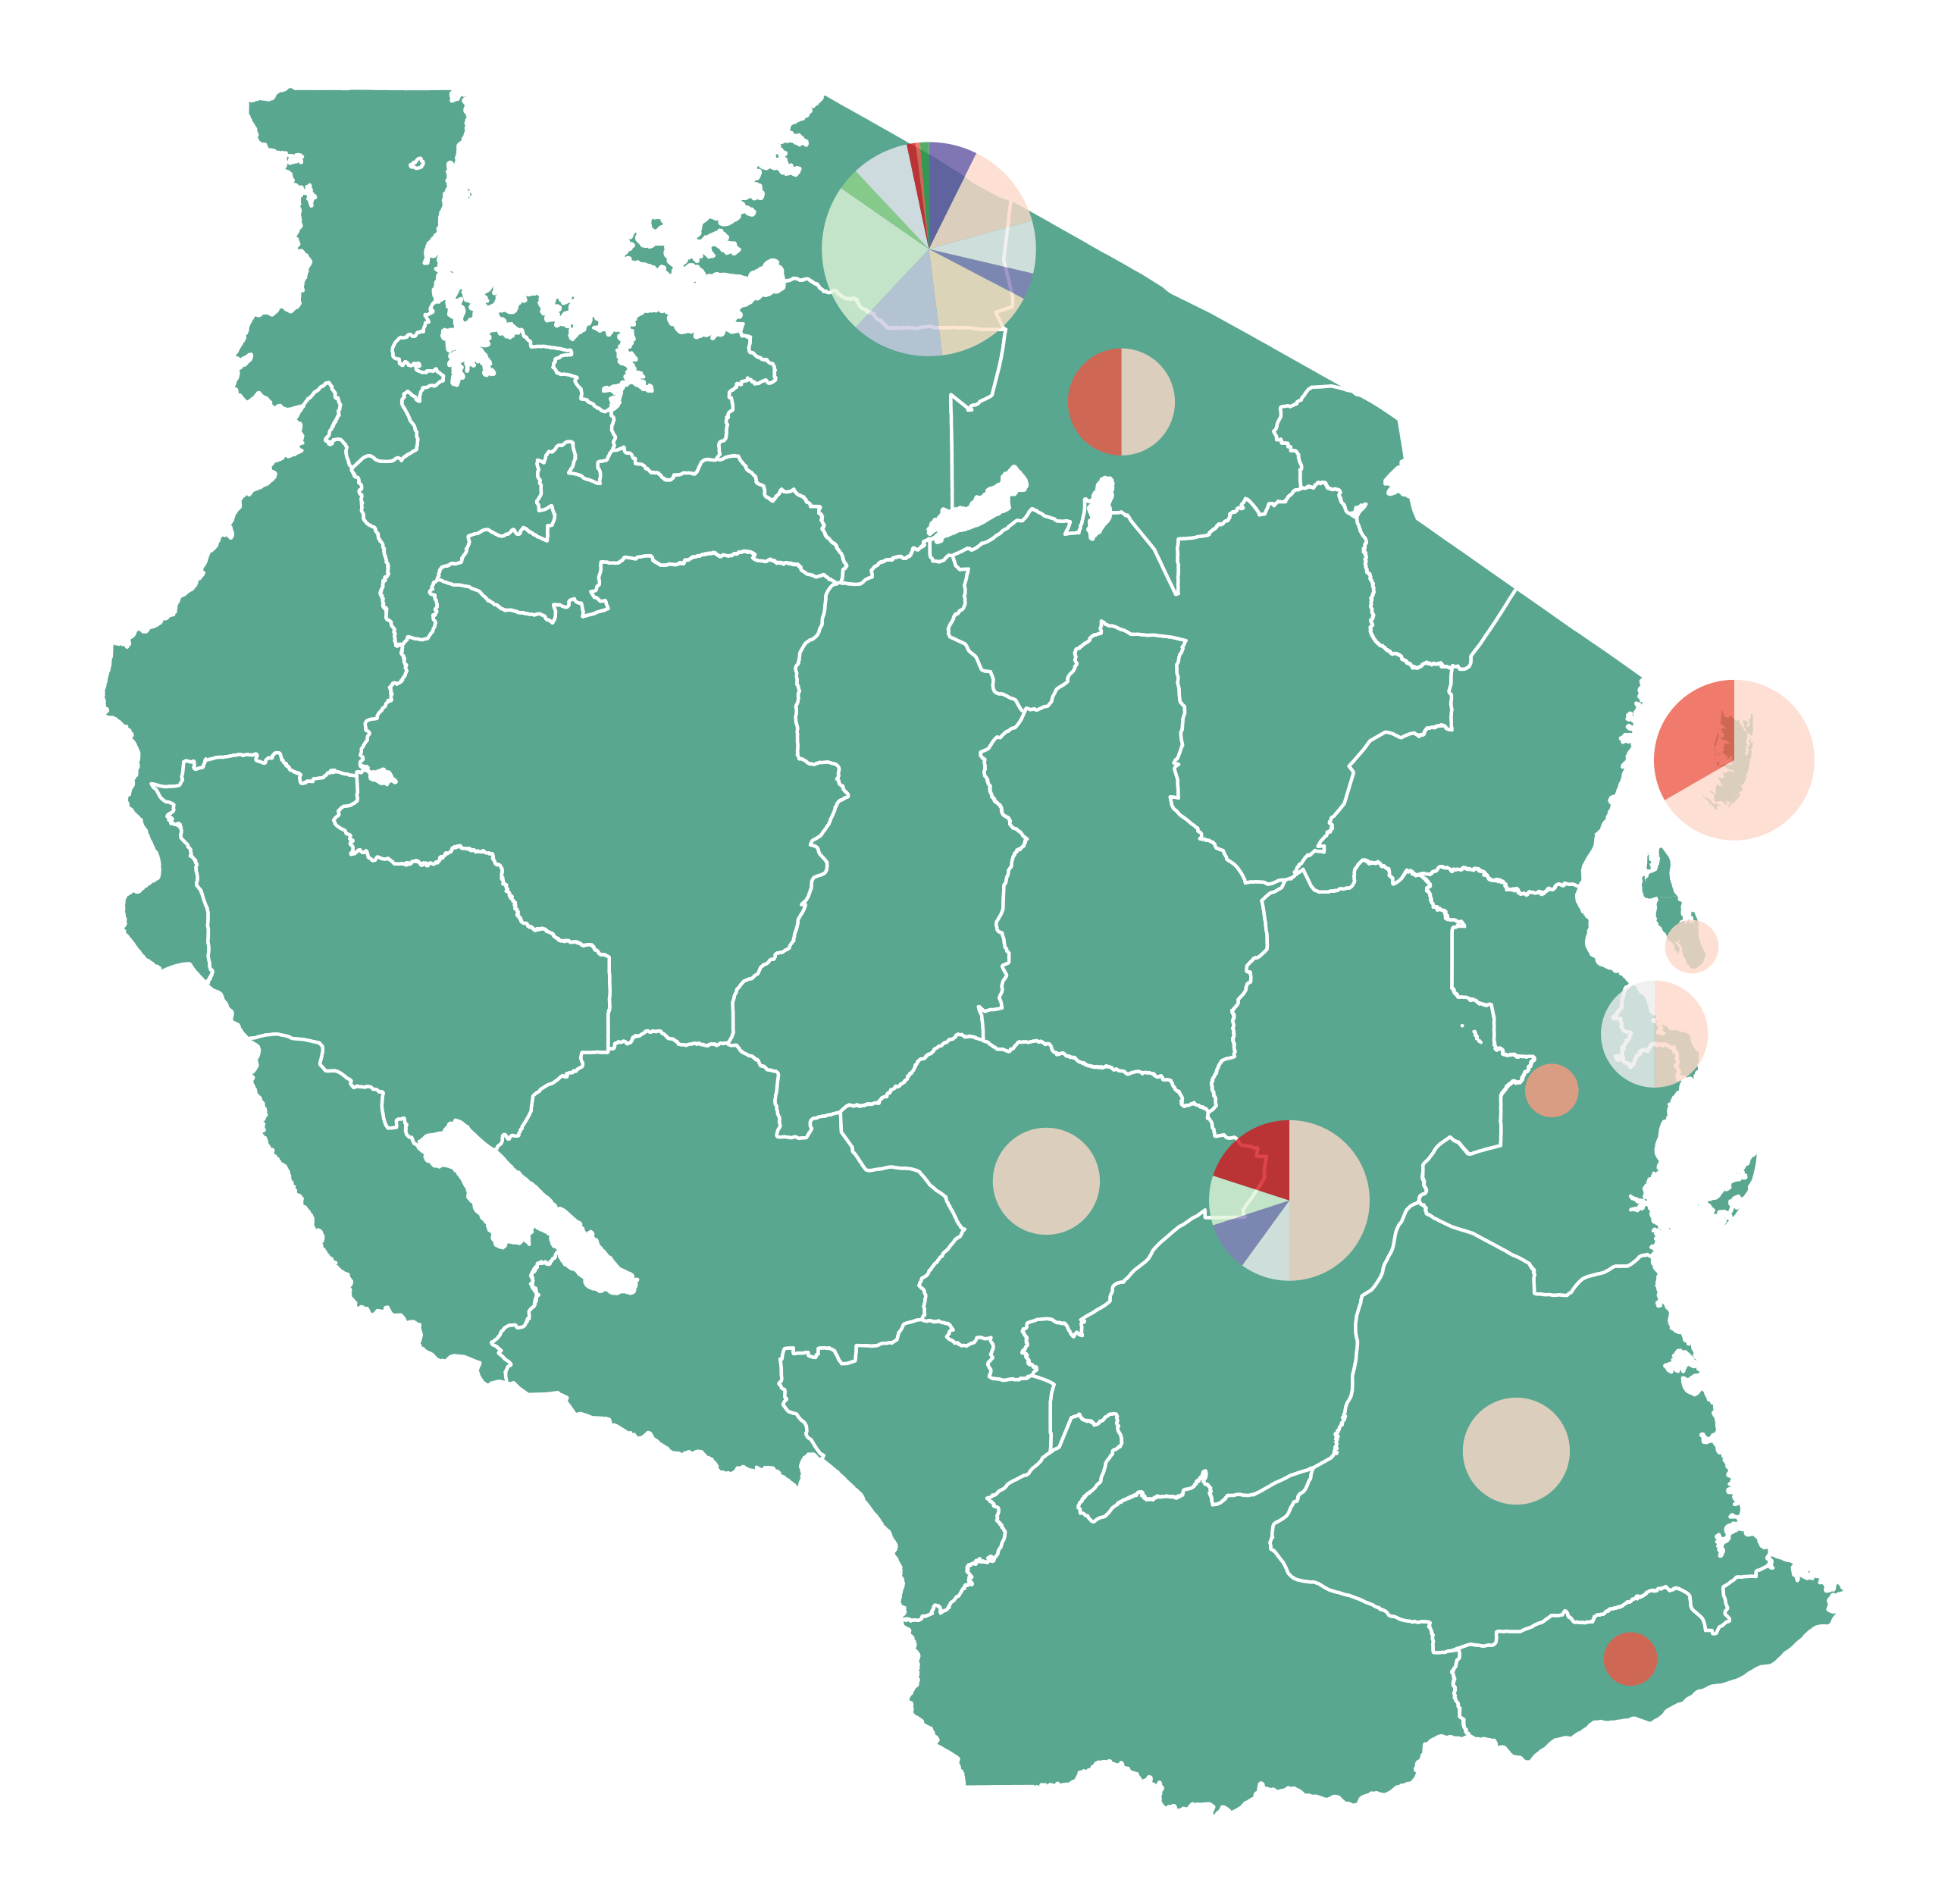
a)
b)
c)
Notes:
Figure 9 - Lineage designation of the 205 whole genome (10,000nt) rabies virus sequences from Tanzania, obtained from RABV-GLUE. A) Maximum likelihood tree showing the lineage positions with terminal lineages collapsed. B) Hierarchical relationships of the lineages.

Slide 10
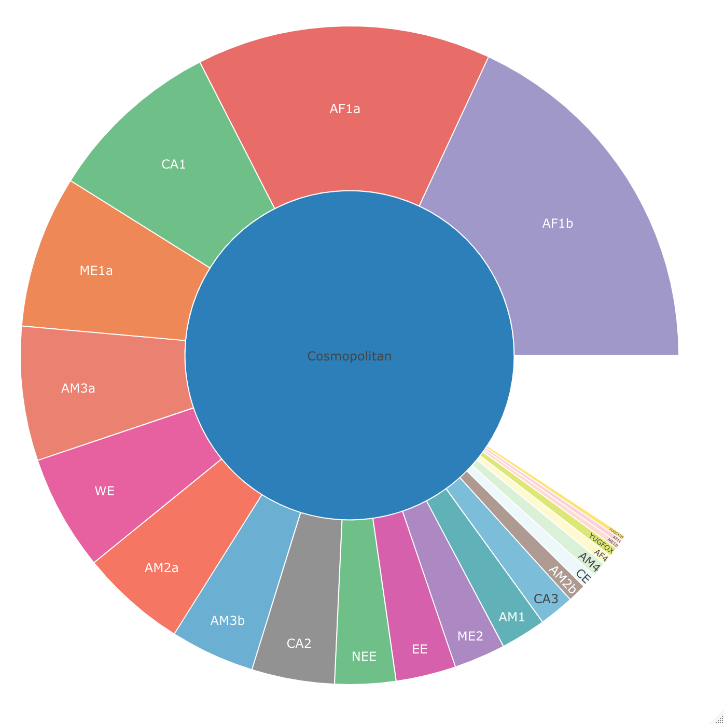
Cosmopolitan
Notes:
Fig10: Hierarchal relationship of the 23 existing subclades of the cosmopolitan clade

